Slide 1


Slide 2
FUNDAMENTALS OF CPMPUTER 3

Slide 3
Operating System
An Operating System (OS) is a software that acts as an interface between computer hardware components and the user.
Every computer system must have at least one operating system to run other programs.
Applications like Browsers, MS Office, Notepad Games, etc., need some environment to run and perform its tasks.
The OS helps you to communicate with the computer without knowing how to speak the computer's language.
It is not possible for the user to use any computer or mobile device without having an operating system.

Slide 4
List of common operating systems
Name of the OS | Release Date
Android | 2008
iOS | 2007
Windows | 1985
Mac OS | 2001
MS-DOS | 1981
Chrome OS | 2011
Windows Phone | 2010
Blackberry OS | 1999
Firefox OS | 2013
UNIX | 1969

Slide 5
MICROSOFT WINDOWS

Slide 6
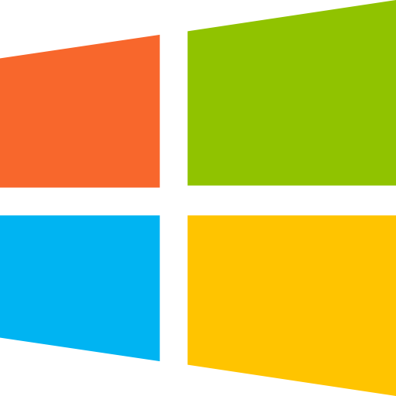
What is MS windows?
Microsoft windows is a type of Operating System available in 32 and 64 bit versions.
It was developed by Microsoft.
It provides a Graphical User Interface (GUI), virtual memory management capabilities, multitasking functionalities and support for many peripheral devices.
The latest version of Microsoft Operating System which is being widely used across the world is Windows 10.
For more information visit: https://byjus.com/govt-exams/microsoft-windows/

Slide 7
Different versions of Microsoft window:
Windows 1.0 | Windows 2.0
Windows 3.0 | Windows 3.1
Windows 95 | Windows 98
Windows ME | Windows 2000
Windows XP | Windows Vista
Windows 7 | Windows 8
Windows 8.1 | Windows 10

Slide 8
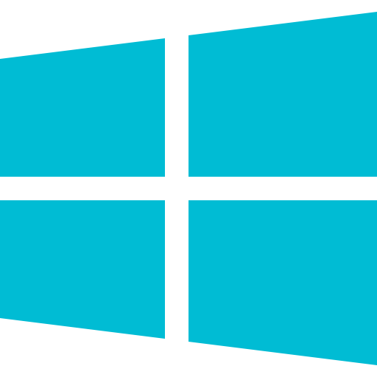
Windows 10
Windows 10 is the latest version from Microsoft.
Windows 10 is a personal computer Operating System developed and released by Microsoft in July 2015.
The major change in windows 10 is the introduction or new default web browser, 'Microsoft Edge', which is designed to replace Internet Explorer (IE) and Cortana - the personal assistant.

Slide 9
LINUX

Slide 10

What is Linux?
The LINUX Operating System is one of the popular versions of Unix OS.
It is freely distributed open source Operating System whose source code is freely available on the internet and can be modified by anyone who uses it.

Slide 11
The features of LINUX Operating System are as follows:
Anyone can modify the source code of LINUX and redistribute it. Hence, it is an open source Operating System.
LINUX Operating System provides better security and hardly gets affected by computer viruses.
LINUX operated computer does not hang, therefore, anyone can run LINUX for days and months without the need to restart the computer.
The LINUX operated computer allows the user to use four desktop screen simultaneously. A user can switch anytime from one desktop screen to another.

Slide 12


